Slide 1
Predictive Modeling for Customer Churn
Made By Abhishek Karande

Slide 2
Business Objective
The objective of this assignment is to build a predictive model that can predict customer churn for a given company.
The intern will use machine learning techniques to build the model and document the process, including feature selection, model evaluation, and performance metrics.

Slide 3
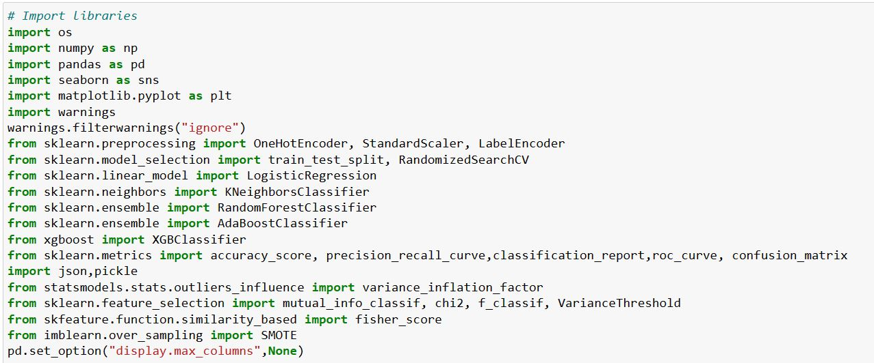
Data Gathering
Importing necessary Libraries:

Slide 4
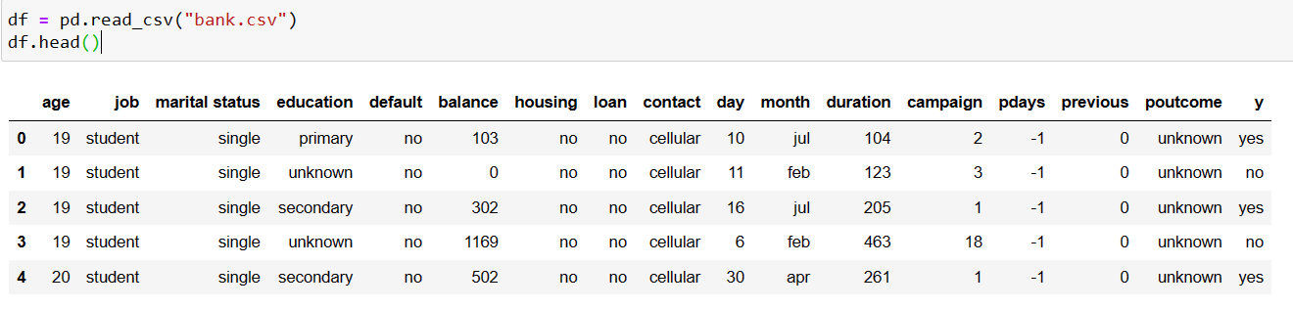
Overview of Data
Attribute Information
- age (numeric)
- job : type of job (categorical: admin", "unknown", "unemployed", "management", "housemaid", "entrepreneur", "student", "blue-collar", "self- employed", "retired", "technician", "services")
- marital : marital status (categorical: "married","divorced","single"; note: "divorced" means divorced or widowed)
- education (categorical: "unknown","secondary","primary","tertiary")
- default: has credit in default? (binary: "yes","no")
- balance: average yearly balance, in euros (numeric)
- housing: has housing loan? (binary: "yes","no")
- loan: has personal loan? (binary: "yes","no")
- contact: contact communication type (categorical: "unknown","telephone","cellular")
- day: last contact day of the month (numeric)
- month: last contact month of year (categorical: "jan", "feb", "mar", ..., "nov", "dec")
- duration: last contact duration, in seconds (numeric)
- campaign: number of contacts performed during this campaign and for this client (numeric, includes last contact)
- pdays: number of days that passed by after the client was last contacted from a previous campaign (numeric, -1 means client was not - previously contacted)
- previous: number of contacts performed before this campaign and for this client (numeric)
- poutcome: outcome of the previous marketing campaign (categorical: "unknown","other","failure","success")

Slide 5
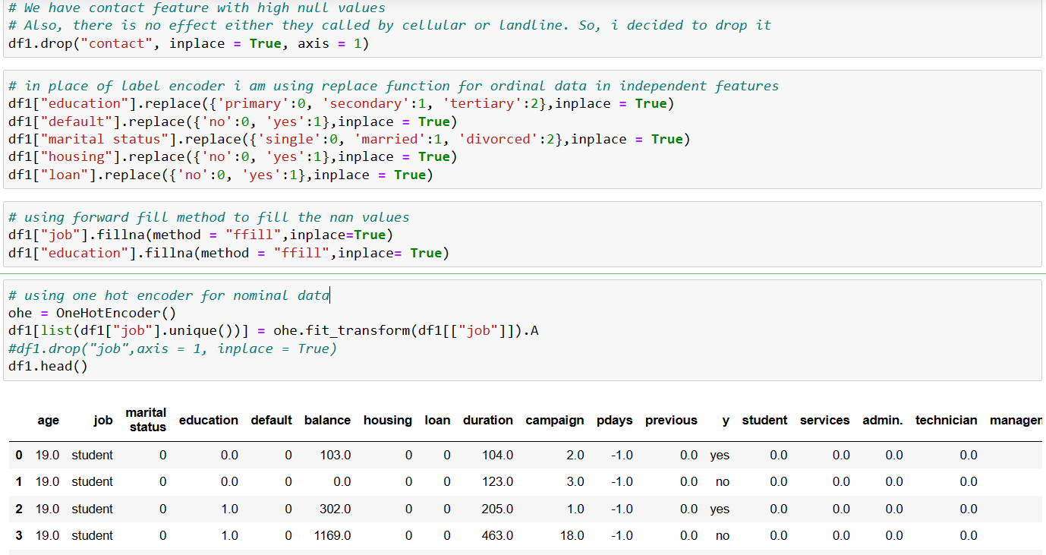
Feature Engineering

Slide 6
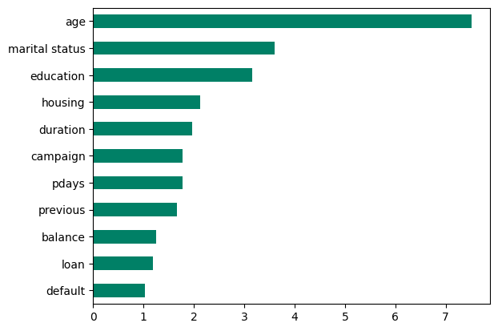
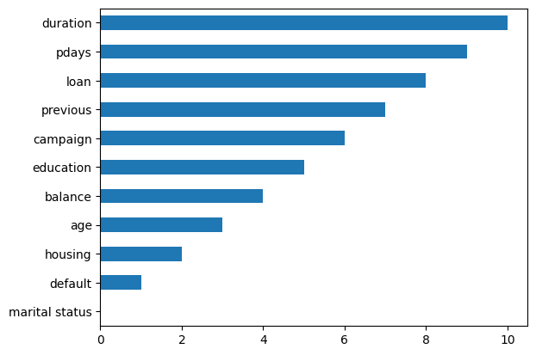
Feature Selection
Checking for Multi-Colinearity
Fisher Score to check participation score of features

Slide 7
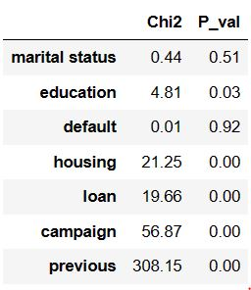
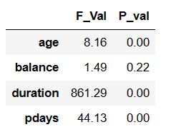
Feature Selection for best results
Chi-2 test(for categorical features)
Chi2 is low and p value is high (means variable is independent from the target feature)
Anova Test (for countinuous features)
(f value is low) and (p value is greater than 0.05) means bad predictor

Slide 8
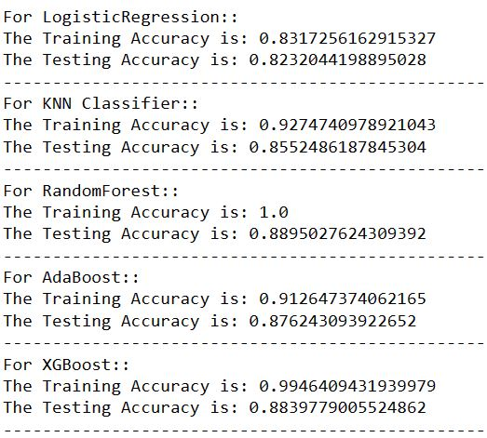
Model Selection
We Use different models for checking the best model for prediction:
Below we see that the Accuracy of models

Slide 9
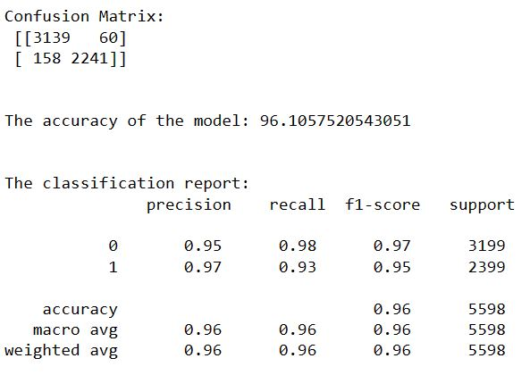
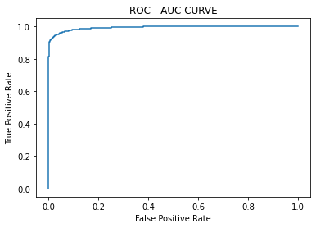
Model Evaluation We are getting good accuracy in xgboost model. So, we will move forward with xgbclassifier model.
Confusion Matrix
ROC-AUC Curve

Slide 10
Thank You

